Slide 1
NCMS CONNECT · COMPLIANCE PACKAGE BUILDER
UI States Review Deck — Part 3
Documents the prototype's current state: five flows, thirty-three states — up from twenty-four in Part 2. Operator Assignment is new; New Version Creation's Change Notice step and two additional package-deactivation states were added. Event Type and Module each lost the Reactivate confirmation Part 2 showed — see Review Notes.
Source: ncms-package-lifecycle-stories.html · Prepared by Swovo Design
Click through live: ncms-package-lifecycle-stories.html — every slide below has a matching card in the Story Hub.

Slide 2
REVIEW NOTES
What changed since Part 2
CONFIRMED IN THIS PASS
OPEN — NEEDS NCMS CONFIRMATION
Operator Assignment is a new flow, not an extension. Five states — entry, selecting operators, a program-mismatch warning, an edited notification, and assigning without notifying — sit alongside the four flows Part 2 covered.
New Version Creation now has a full Change Notice step. Three states — the default post-publish draft, the contractor-specific draft edited, and the record of dismissing it — cover what happens after a version publishes, not just the trigger and impact.
Package deactivation branches on what the pre-check finds. Two more states show the plain confirm when operators keep other packages, and when a package was never assigned to anyone — both cases where nothing needs to be replaced.
Compliance Grants gained an operator-side view. The same grants, scoped to one operator, read-only — the mirror of the package page's own Compliance Grants tab.
Event Type and Module no longer have a Reactivate confirmation. Part 2 documented one state for each; neither exists in the prototype's current story list. Confirm whether that's an intentional scope cut (in line with events/modules having no versioning) or something to restore.
Every state in this deck is reachable in the live prototype via the Story Hub — five flows, thirty-three cards, one per slide.

Slide 3
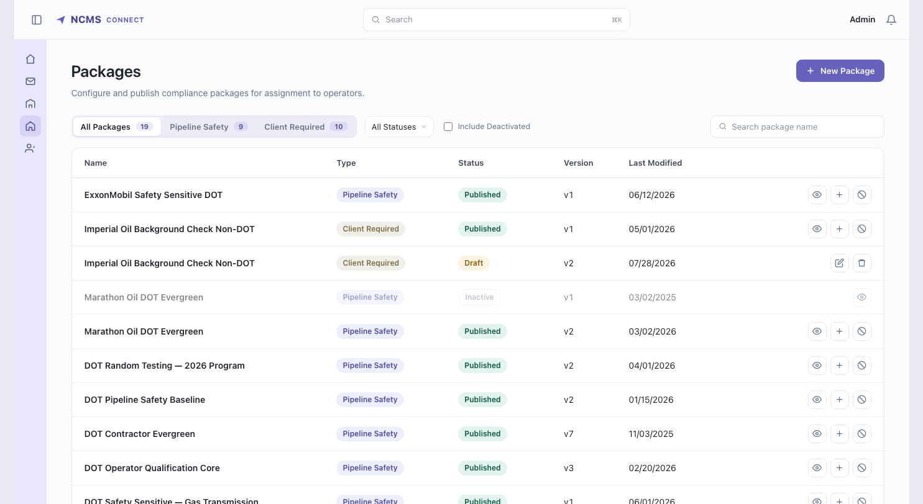
NEW VERSION CREATION FLOW
Trigger — from the Package Library list
Clicking "New Version" on a Published package clones it into a new Draft (v2) and opens the builder directly.

Slide 4
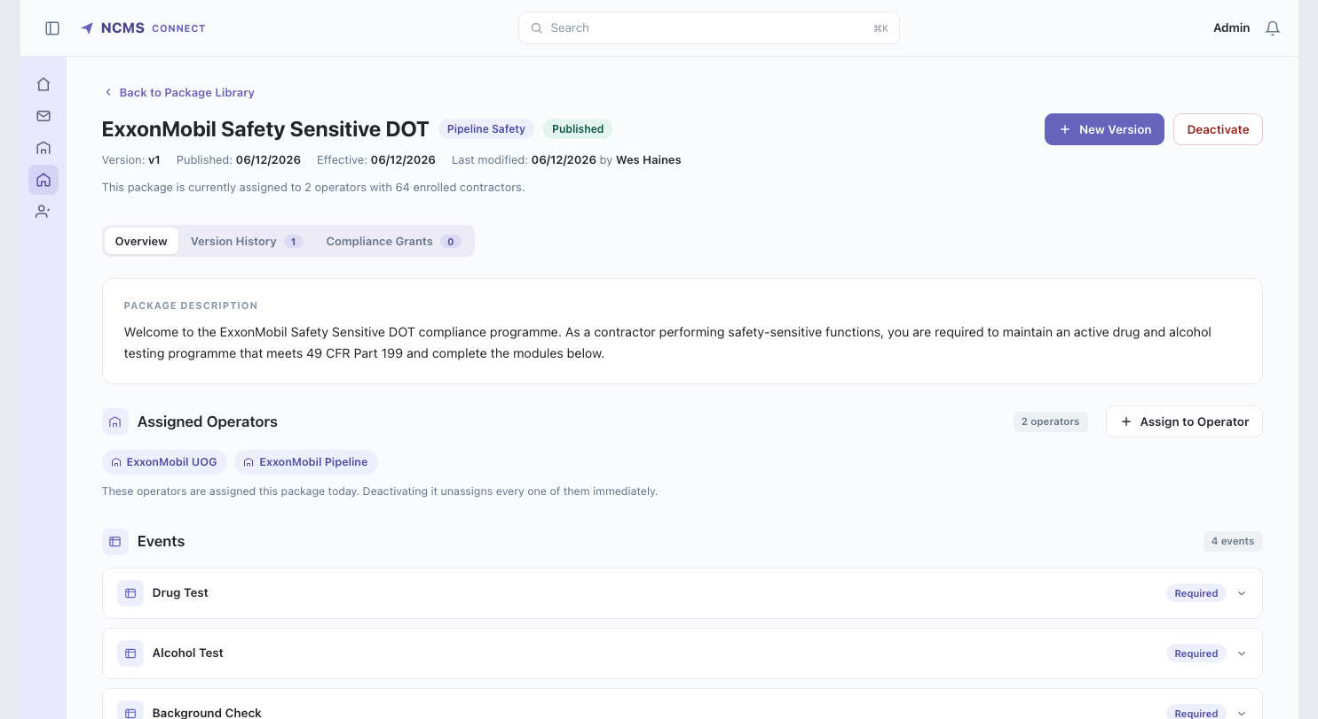
NEW VERSION CREATION FLOW
Trigger — from the package detail page
The same action is also available from the published package’s own detail page header.

Slide 5
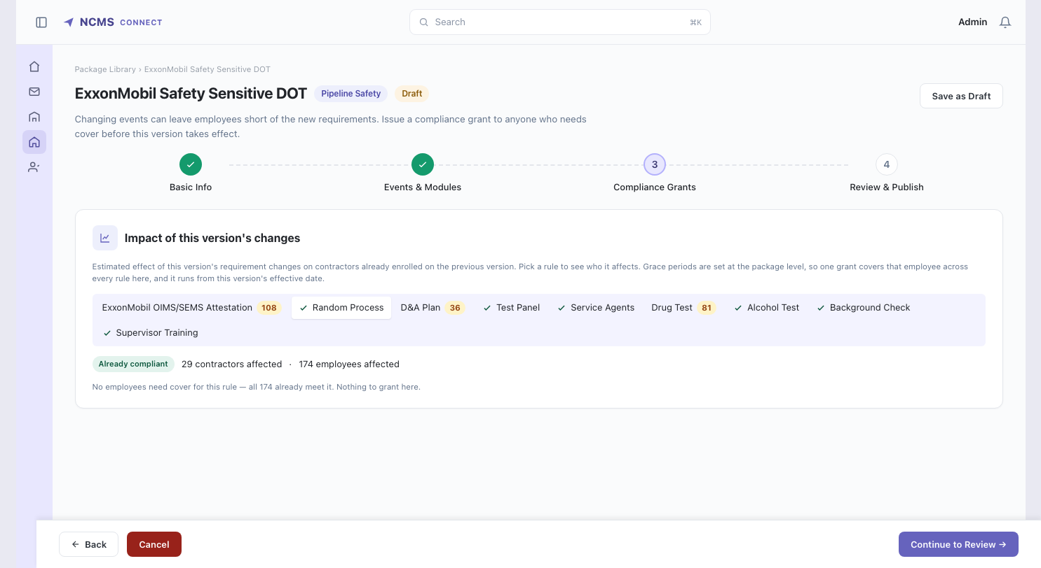
NEW VERSION CREATION FLOW
A rule with nothing to grant
Switching to a rule everyone already meets says so outright, instead of leaving an empty list to interpret.

Slide 6
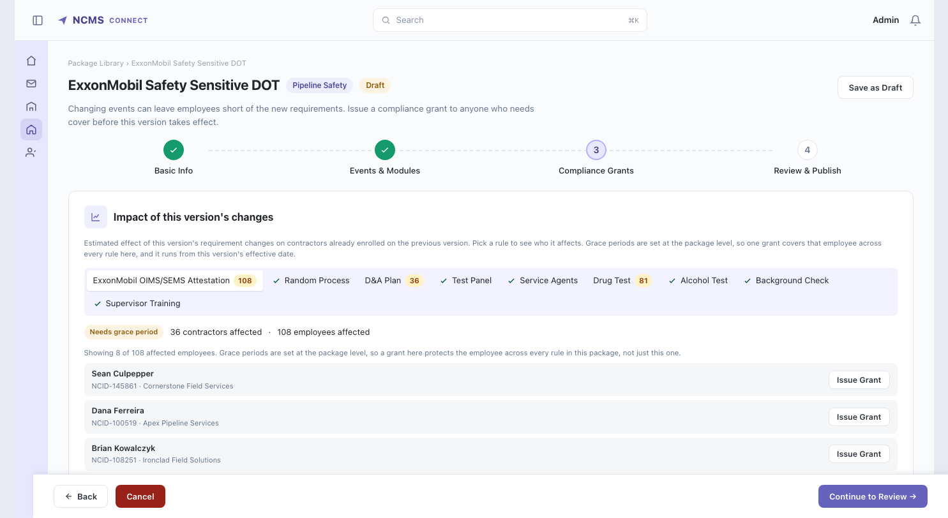
NEW VERSION CREATION FLOW
Compliance Grants step — one tab per changed rule
Its own step, shown only when events changed. Each tab carries a count of who needs cover, or a tick when nobody does.

Slide 7
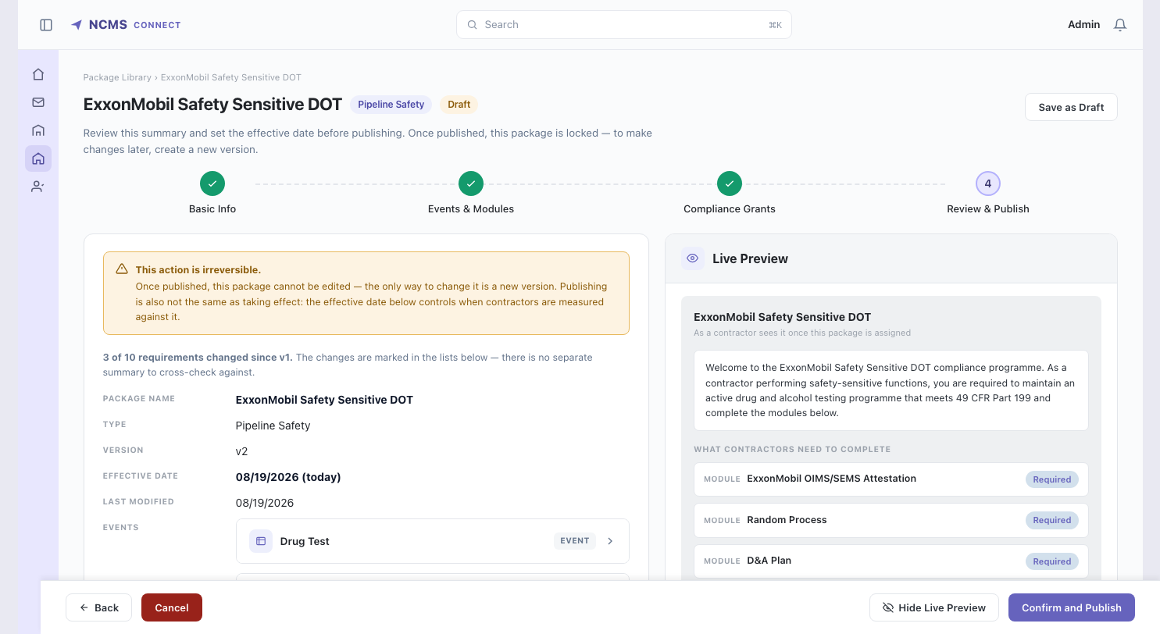
NEW VERSION CREATION FLOW
What happens to the previous version
No longer a choice: the previous version becomes Inactive on the new version’s effective date, so contractors are never between versions.

Slide 8
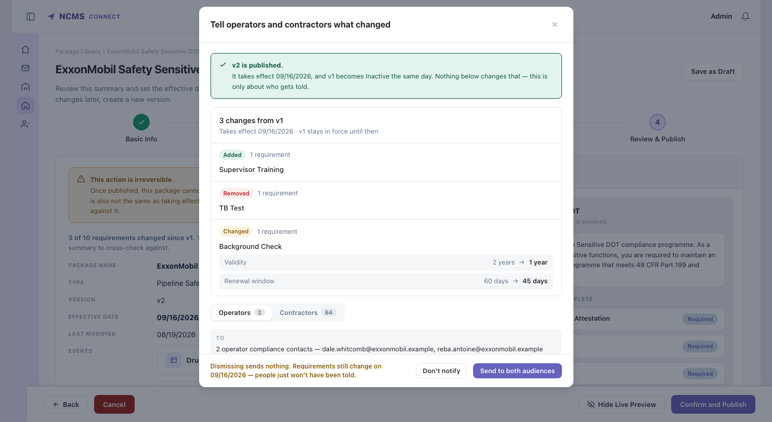
NEW VERSION CREATION FLOW
NEW STATE
Change notice — the modal after publishing
Publishing is already done by the time this appears, so drafting an email can never block or reverse it. Two drafts built from the real differences against the previous version.

Slide 9
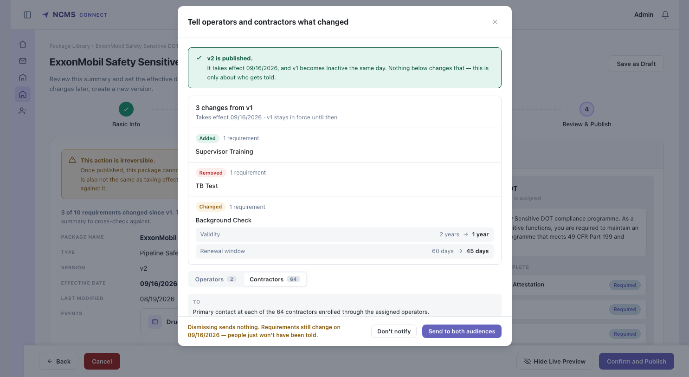
NEW VERSION CREATION FLOW
NEW STATE
Change notice — the contractor draft, edited
The contractor version leads with what they personally have to do and by when. Editing it stops it regenerating, and says so instead of discarding the edit.

Slide 10
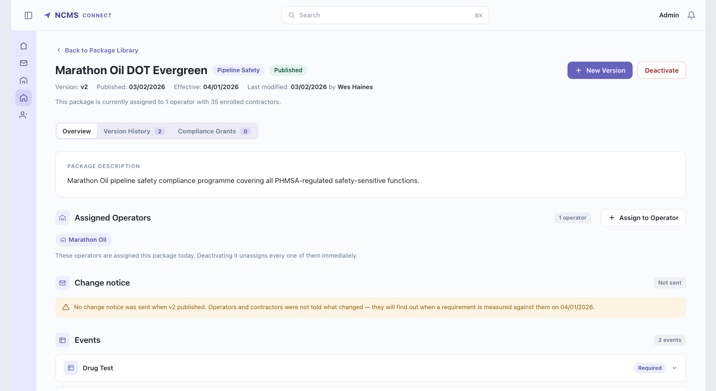
NEW VERSION CREATION FLOW
NEW STATE
Dismissed — the record of not telling anyone
The modal can be dismissed and nothing is sent. That is recorded on the package page rather than left as a silent gap, so "nobody was told" is visible afterwards.

Slide 11
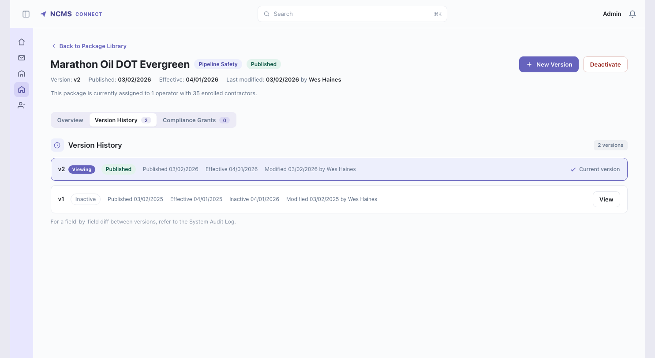
NEW VERSION CREATION FLOW
Version History after the switchover
The seeded Marathon chain: v2 published 03/02/2026, effective 04/01/2026 — v1 went Inactive on the effective date, four weeks after v2 was published.

Slide 12
PUBLISH & EFFECTIVE DATE
Effective Date — required, defaults to today
New on the publish step. The compliance timer starts on this date, not on the publish date. Clearing it blocks Confirm and Publish.

Slide 13

PUBLISH & EFFECTIVE DATE
Effective Date set ahead of publish
Publishing puts the package in the library immediately, but nothing is measured against it until the effective date — the contractor’s lead time.

Slide 14
OPERATOR ASSIGNMENT
NEW STATE
Entry — Assign to Operator on the package page
A published package shows who it is assigned to; the action to add another operator sits with that list, not buried in a menu.

Slide 15
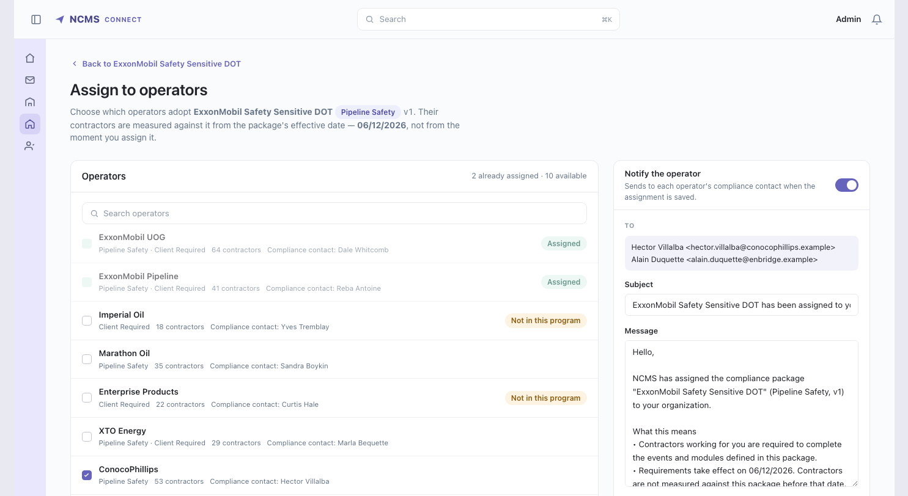
OPERATOR ASSIGNMENT
NEW STATE
Selecting operators
Already-assigned operators are shown as such and can’t be picked twice. The running total says how many contractors the assignment actually reaches.

Slide 16
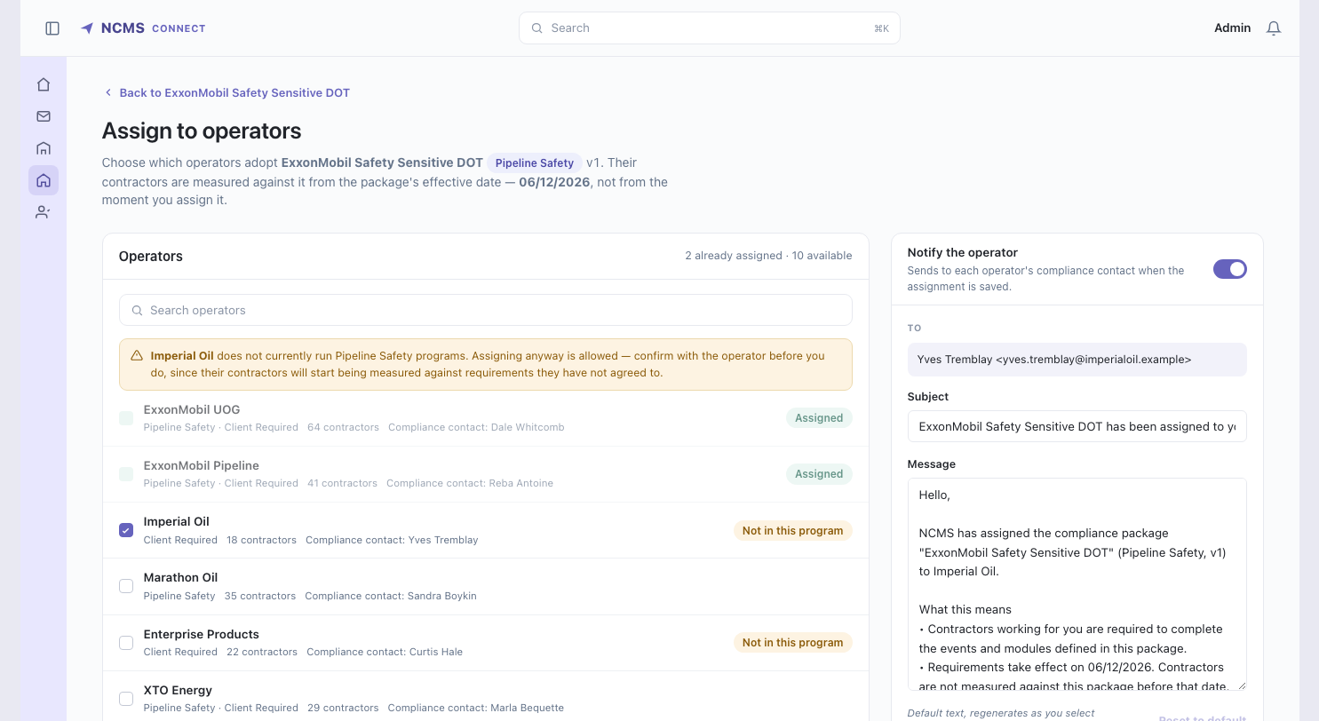
OPERATOR ASSIGNMENT
NEW STATE
Operator doesn’t run this program
Assigning a Pipeline Safety package to a Client-Required-only operator is flagged, not blocked — NCMS may be onboarding them into it.

Slide 17
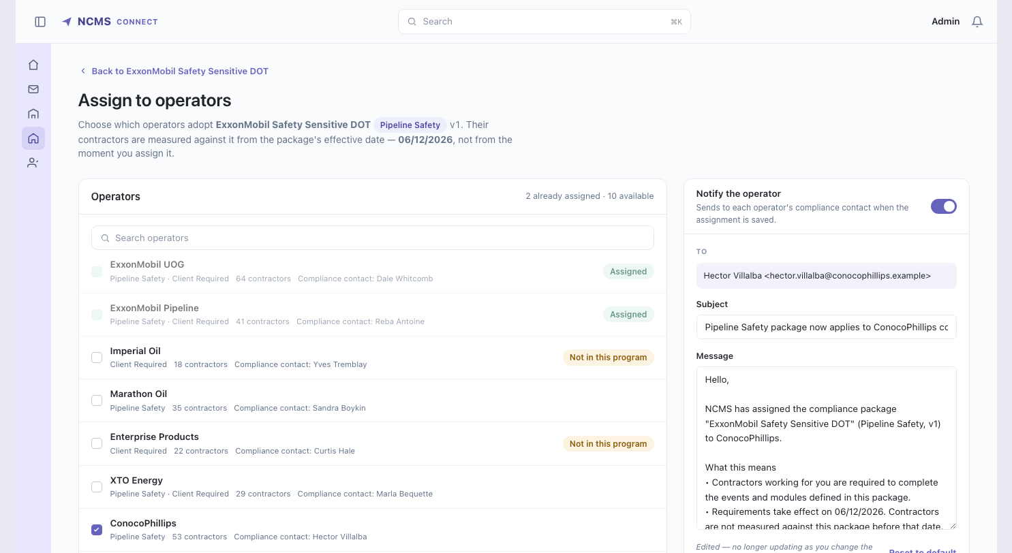
OPERATOR ASSIGNMENT
NEW STATE
Editing the operator notification
The notice defaults from the package and its effective date. Typing in it stops it regenerating, and says so rather than silently discarding the edit.

Slide 18
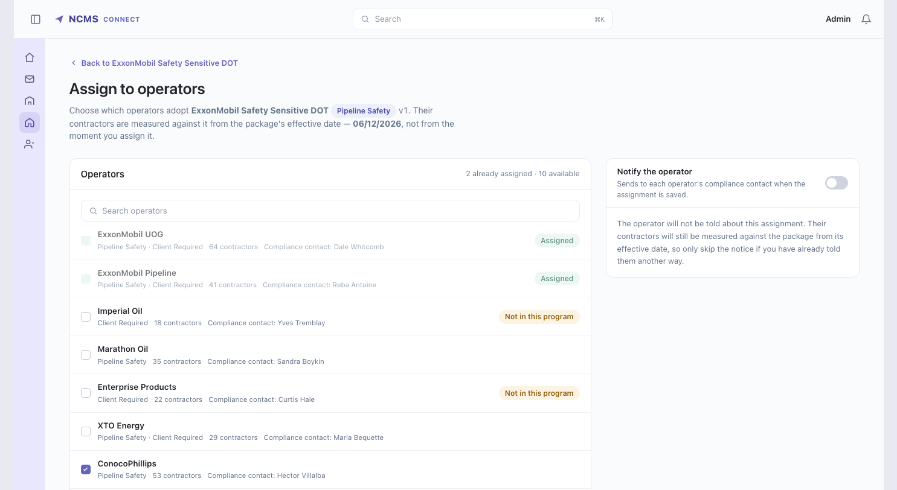
OPERATOR ASSIGNMENT
NEW STATE
Assigning without notifying
Allowed, with the consequence stated plainly: contractors are still measured from the effective date, the operator just won’t have been told.

Slide 19
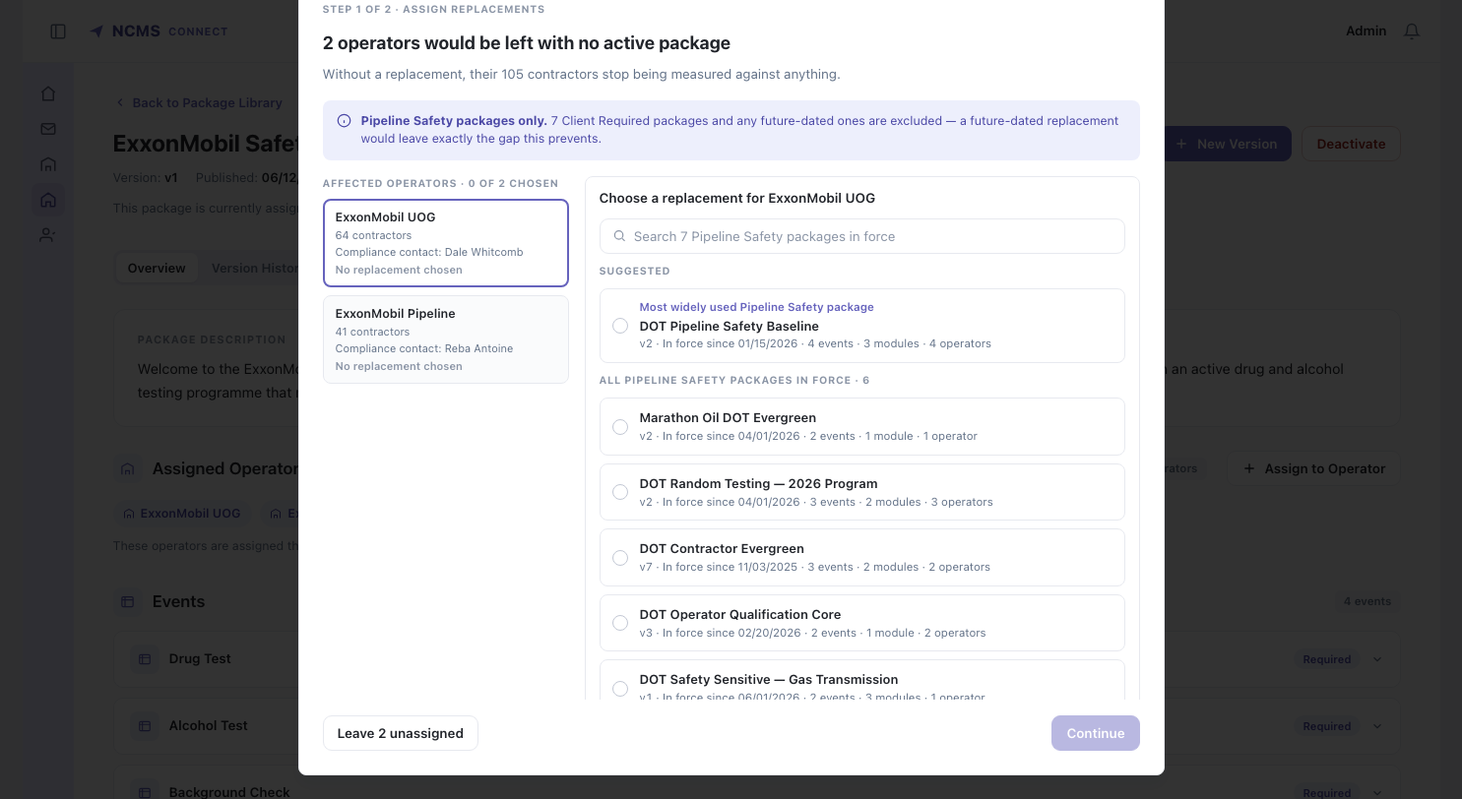
DEACTIVATION FLOWS
Package — Deactivate confirmation — replacements needed
The pre-check runs first: this package is the only active one for two operators, so the confirm is replaced by the assign-replacements step.

Slide 20
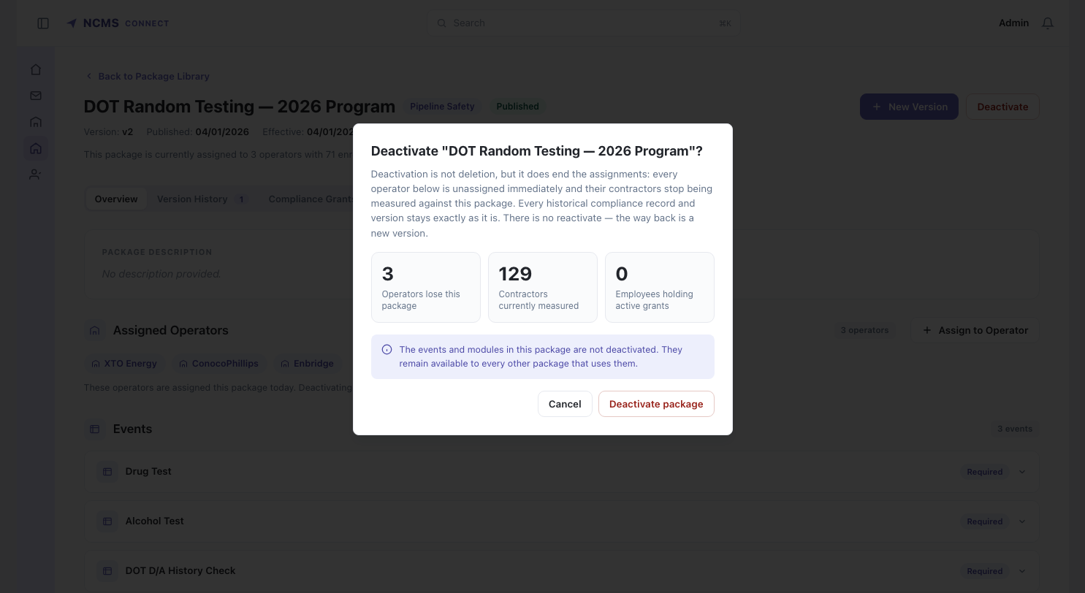
DEACTIVATION FLOWS
NEW STATE
Package — Deactivate confirmation — operators keep other packages
Nothing is stranded, so the plain confirm shows, leading with what deactivating costs: operators, contractors measured, and employees holding active grants.

Slide 21
DEACTIVATION FLOWS
NEW STATE
Package — Deactivate confirmation — no operator assigned
Never assigned to anyone, so there is nothing to strand and no replacement to choose. Same confirm, all three counts at zero.

Slide 22
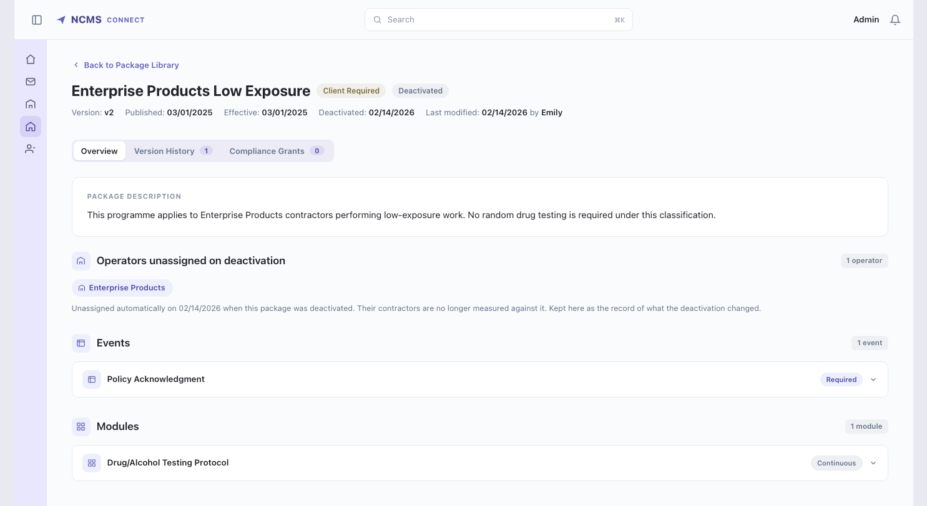
DEACTIVATION FLOWS
Package — A deactivated package
Read-only and one-way. Assignments, enrollments, grants, and history are all still there.

Slide 23
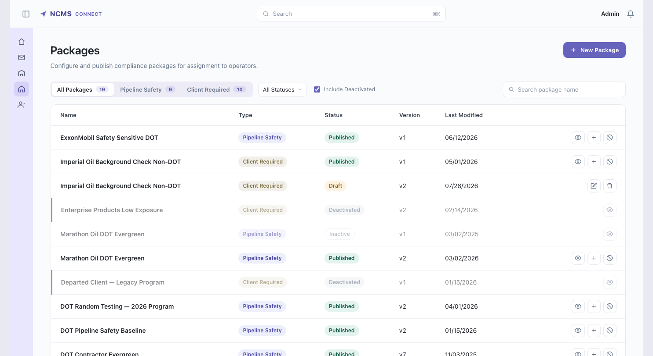
DEACTIVATION FLOWS
Package — Library — Include Deactivated
Deactivated packages are hidden by default; the toggle surfaces them. Inactive ones stay visible — contractors were audited against them.

Slide 24
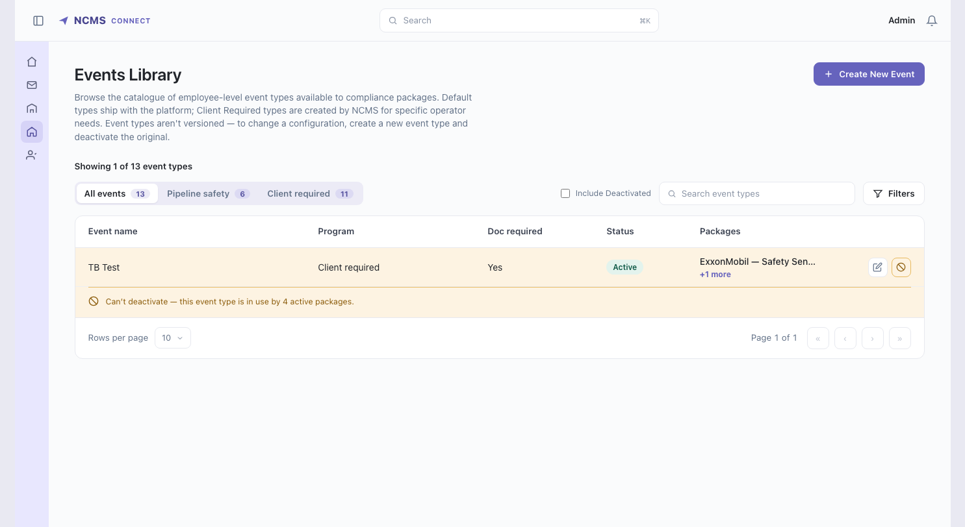
DEACTIVATION FLOWS
Event Type — Deactivation blocked — in use
TB Test is required by two published packages. The pre-check runs on render, so the action is already unavailable; clicking it explains why inline, naming both packages.

Slide 25
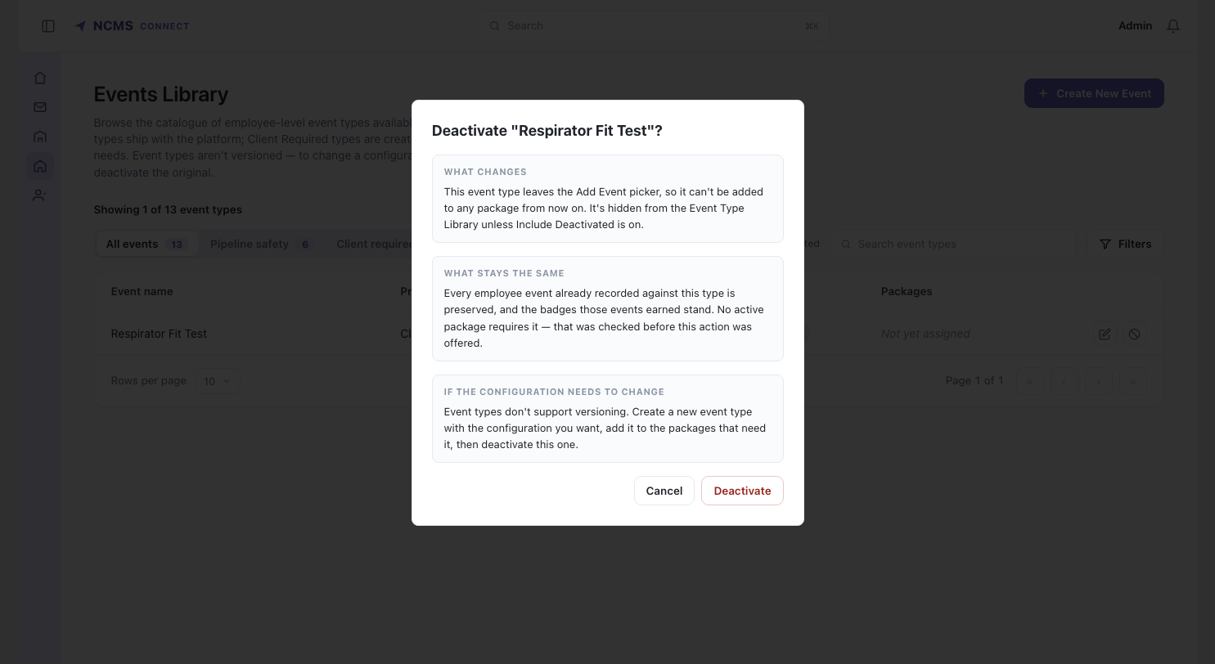
DEACTIVATION FLOWS
Event Type — Deactivate confirmation
Available once no active package requires it. States the no-versioning rule: change a configuration by creating a new event type, not by editing this one in place.

Slide 26
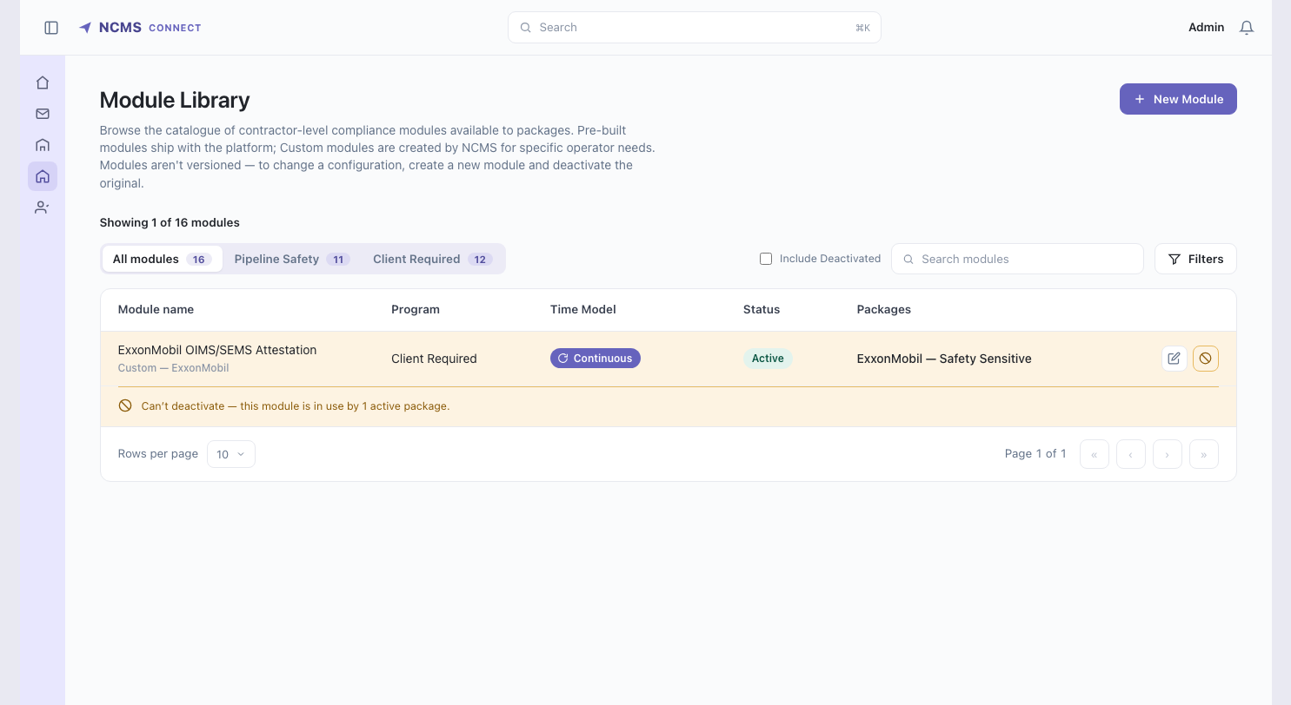
DEACTIVATION FLOWS
Module — Deactivation blocked — in use
Same pre-check, singular case: one published package holds the ExxonMobil OIMS/SEMS module. Inline message, not a modal.

Slide 27
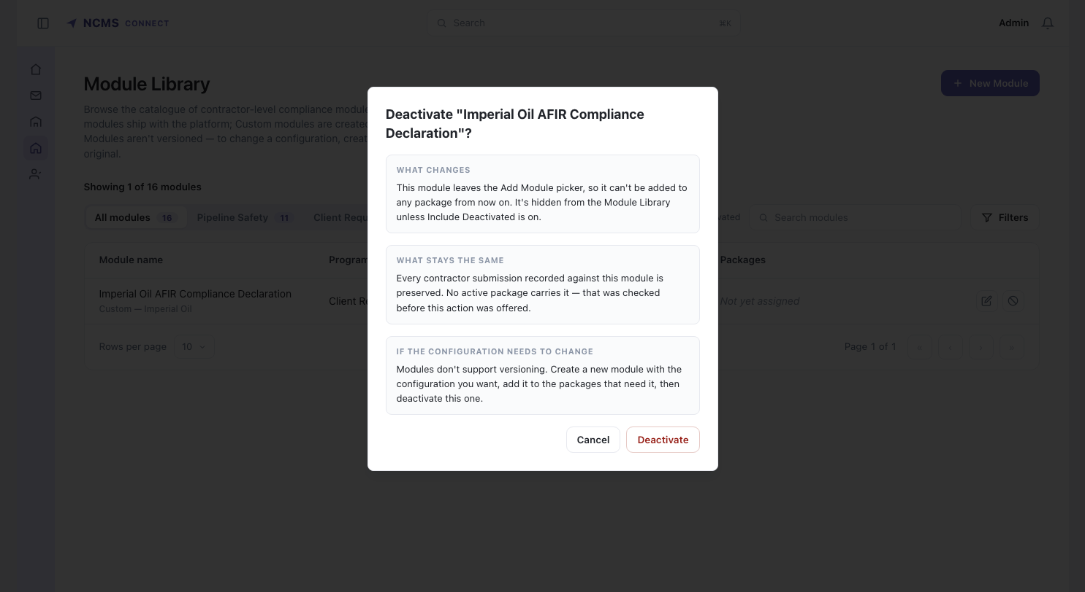
DEACTIVATION FLOWS
Module — Deactivate confirmation
Offered only for Custom-source modules, and only when no active package carries them. Carries the same no-versioning rule.

Slide 28
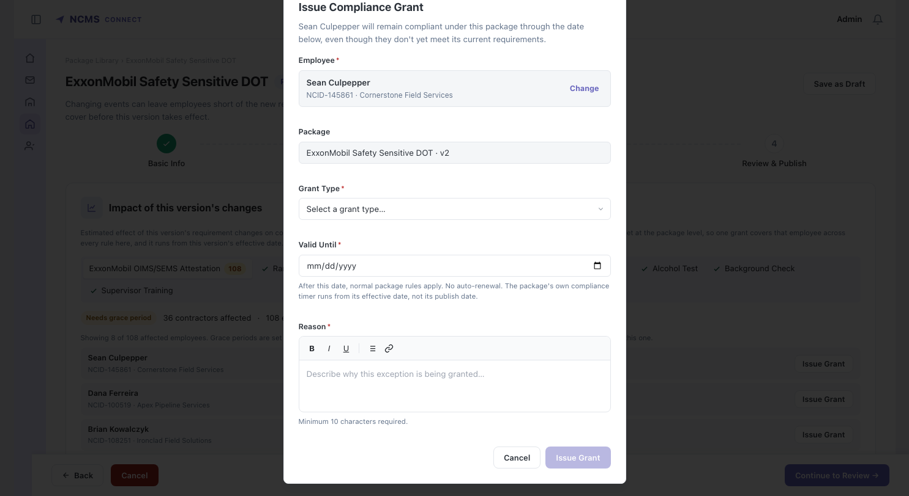
COMPLIANCE GRANT CREATION & MANAGEMENT
Entry point 1 — Issue Grant (from impact assessment)
Employee arrives pre-filled from the impact table row; admin can still search and swap via Change.

Slide 29
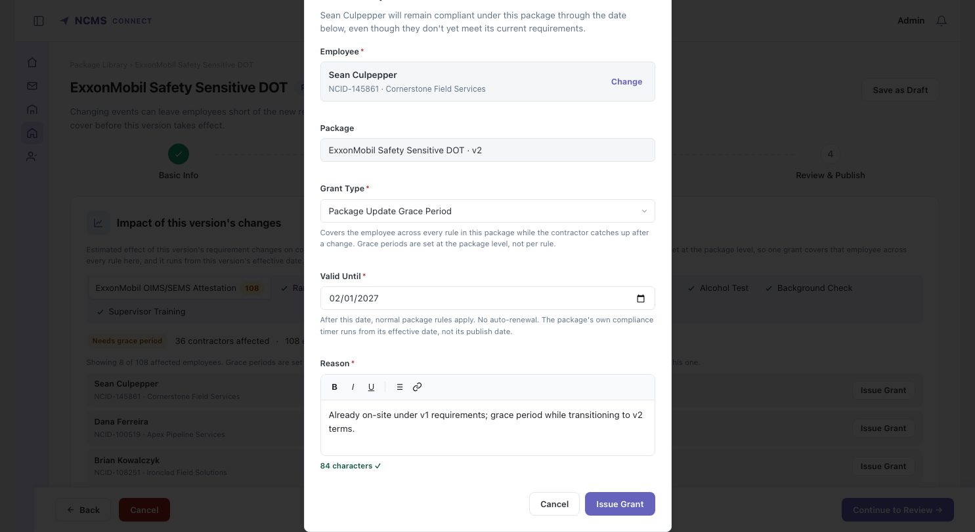
COMPLIANCE GRANT CREATION & MANAGEMENT
Grant form — filled and valid
Grant Type shows its plain-language description inline; Reason enforces a live 10-character minimum.

Slide 30
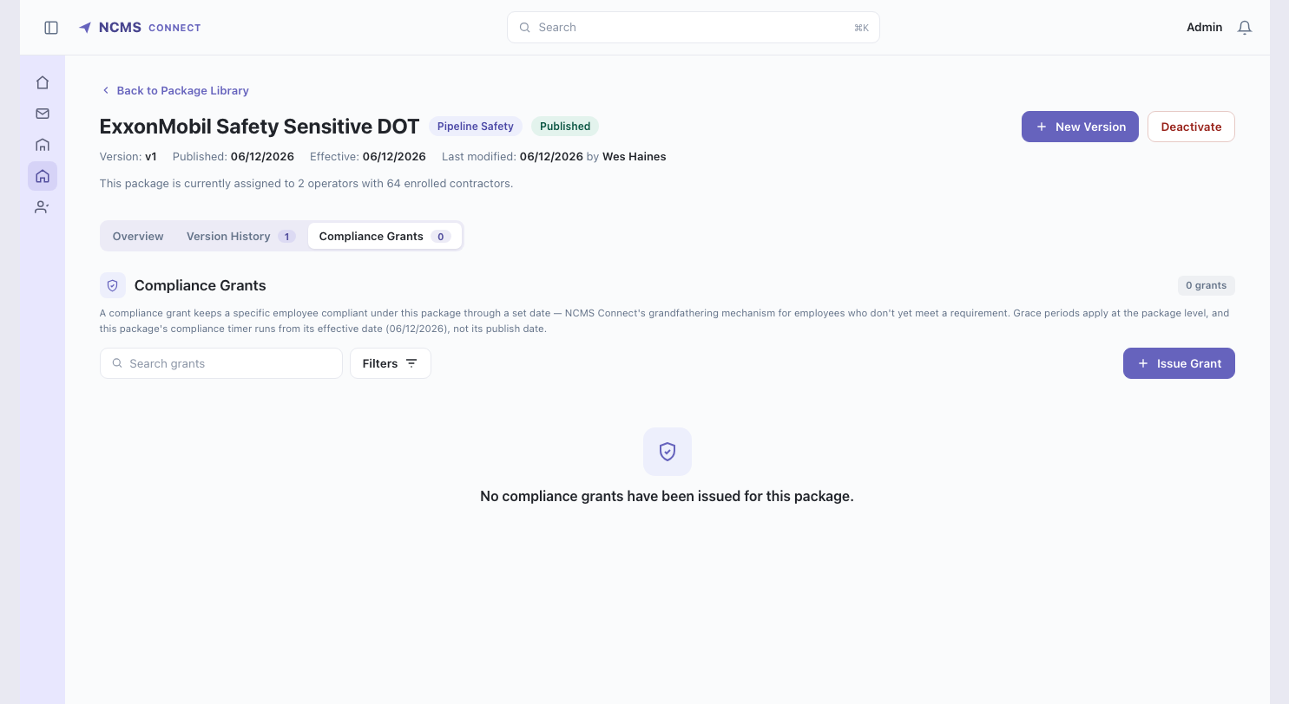
COMPLIANCE GRANT CREATION & MANAGEMENT
Entry point 2 — Compliance Grants tab (empty)
New tab on the published package detail page, alongside Overview and Version History.

Slide 31
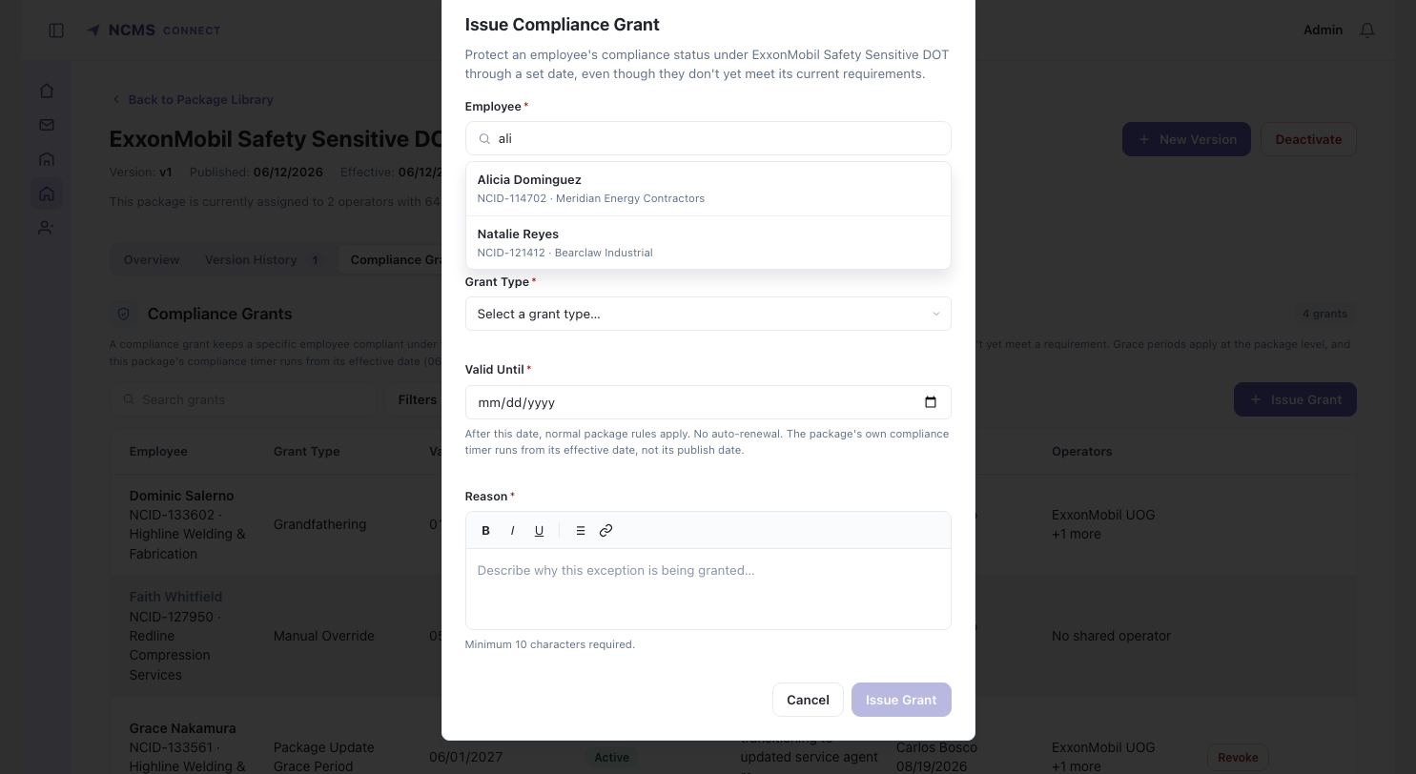
COMPLIANCE GRANT CREATION & MANAGEMENT
Standalone Issue Grant — live NCID search
Typing filters by name, NCID, or contractor; results show all three for unambiguous confirmation.

Slide 32
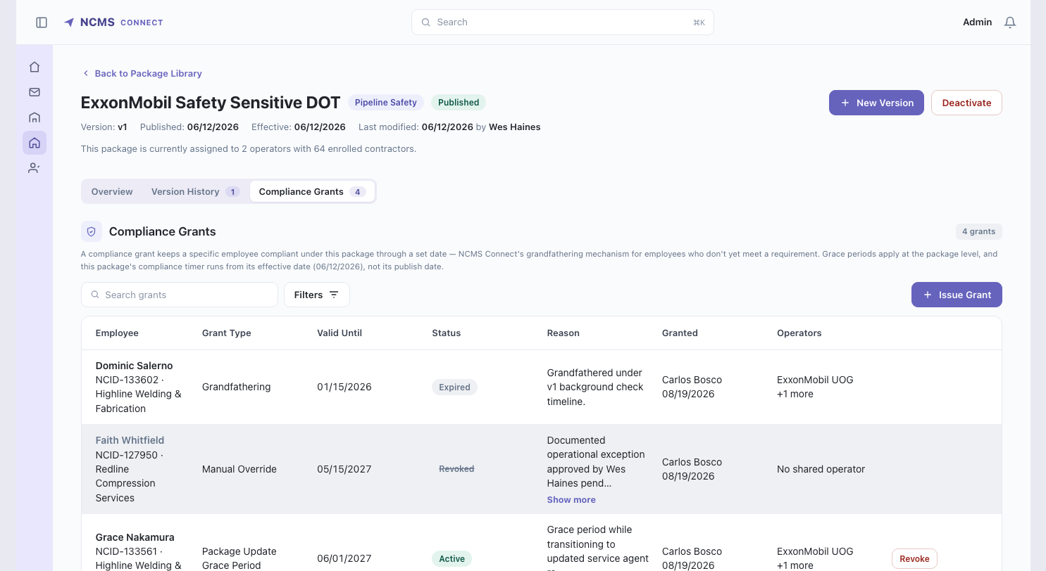
COMPLIANCE GRANT CREATION & MANAGEMENT
Grants list — Active, Expired & a long reason
Sorted by soonest-expiring first; long reasons truncate with a Show more toggle.

Slide 33
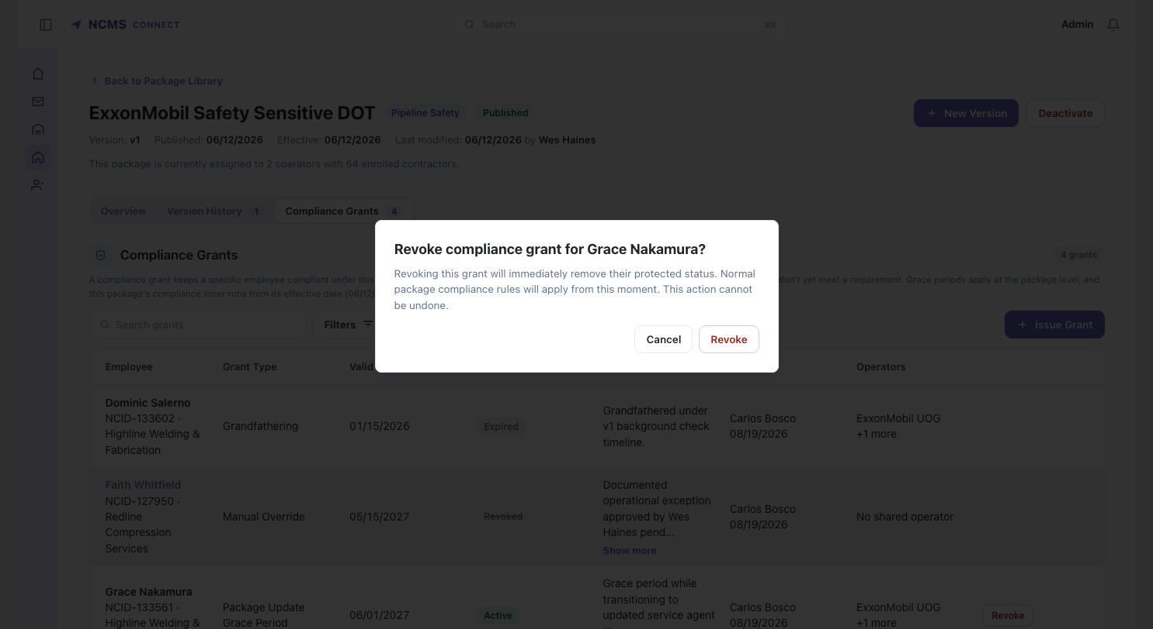
COMPLIANCE GRANT CREATION & MANAGEMENT
Revoke confirmation
Explicit destructive-consequence language; the action cannot be undone.

Slide 34
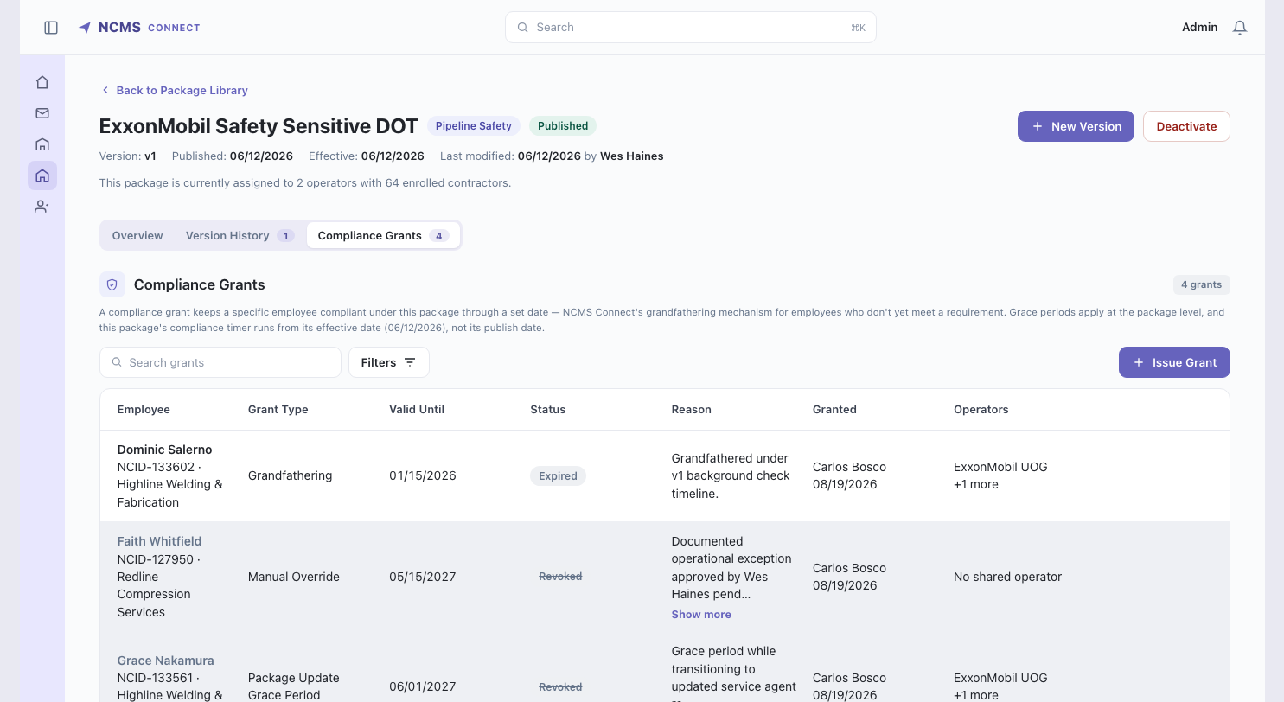
COMPLIANCE GRANT CREATION & MANAGEMENT
Post-revoke — Expired, Revoked & Active together
Revoked grants remain permanently visible with a muted, strikethrough treatment — never hidden from the list.

Slide 35
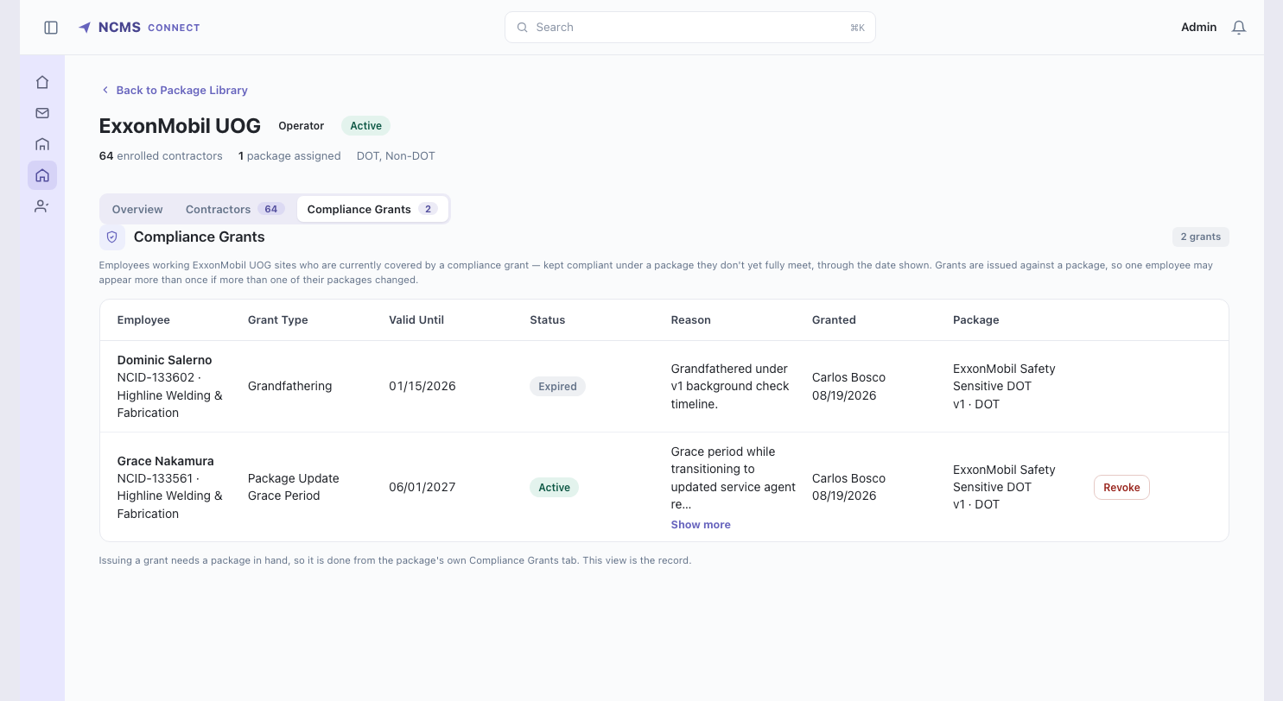
COMPLIANCE GRANT CREATION & MANAGEMENT
NEW STATE
The same grants, seen from the operator
Scoped to one operator, so the varying column is which package produced each grant — the mirror of the package page. Read-only: issuing needs a package in hand.

